Slide 1
How my player’s characters
are kicking the bucket
“The fear of death follows from the fear of life. A man who lives fully is prepared to die at any time.”
Mark Twain (But also Duke Vorgen)

Slide 2
Contents of this Powerpoint
Stargazers
Dreamlanders
A lil surprise

Slide 3
☆⭒Stargazers⭒☆

Slide 4
Sarah J. Maas
“And they will never know what it is to look up at the night sky and wish.”

Slide 5
Lorentz
01
Explodes in a flurry of angelfire
Dies in childbirth (Castor) ((See above))
Gives in to Vasile and they become lovers for all of eternity (or at least like 5 years)

Slide 6
Tokas
02
Experiments with things he should not and dies
Perishes in an alchemical fire
Eaten by a cranky dragon after questioning it about too many things

Slide 7
Vittorio 5-13
03
Pokes his head into Company secrets and kills himself with 3 blackpowder shots to the back of his head
Sleeps with Claymore called Mantis who eats his head after copulation

Slide 8
Zarius
04
Eaten by his shadow clone jitsu Patron
Plays off-key in front of the Burach’s Emperor
Dies in a drunken barfight with a guy who has a three-tailed scorpion tattoo.

Slide 9
🤡Dreamlanders🤡
There are two types of people in the world
Hates Clowns
Is a Clown

Slide 10
“I remain just one thing, and one thing only, and that is a clown. It places me on a far higher plane than any politician”

Slide 11
Abraxas
01
Tries to become a full elf and is killed by the Skinwalker
Scams the wrong kind of people out of their coin
Is not resistant to the toxic damage from the relationships he keeps engaging in

Slide 12
Alin
02
Tries to make friends with an unfriendly monstrosity
Trapped by a Tzeentchian daemon who poses the choice between math tests and death
Forgets the directions given to them in the mists and gets lost forever. Technically this is death.. I think

Slide 13
Hallbjorn
03
Torn to bits by a Winter Wolf which he is trying to tame
“Talk about your feelings or take 25” (arrows to the chest)
Infected by a schnozzling and dies of clown disease

Slide 14
Masq
04
Lost in the madness of their patron
Shivved in the street in an all out clown-on-clown gangwar
Shapechanges into the target of an assassination and dies in their stead

Slide 15
Unit
05
Realises that cultivating a soul and emotions can give you depression → Deactivates himself indefinitely.
Mistaken for scrap metal when resting and repurposed into a fashionable modern chair design

Slide 16
Bonus Round!
Mazati
01
Delilah
03
Vasile
02
Sairen
04
Too handsome for his own good. Probably killed by the lover of someone he slept with
… Men
Need I say more?
Grows his humanity, momentarily forgets he is a vampire like the absolute human he is → Accidentally walks into the sun
Steals from the wrong people (AGAIN)

Slide 17
Thanks!

Slide 18
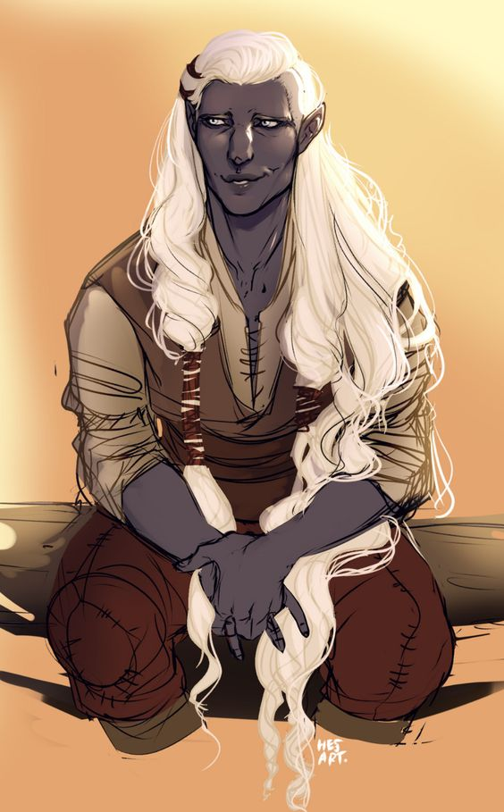
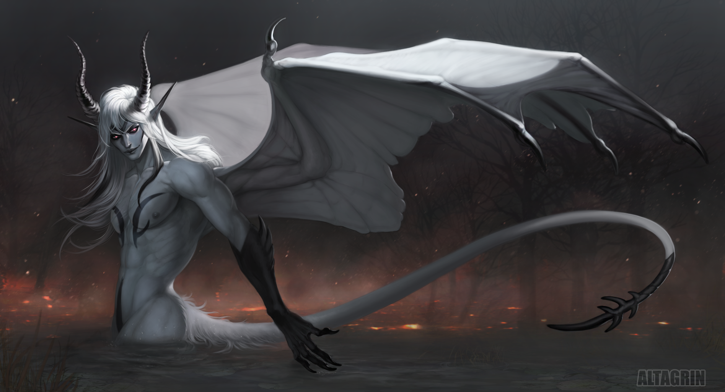
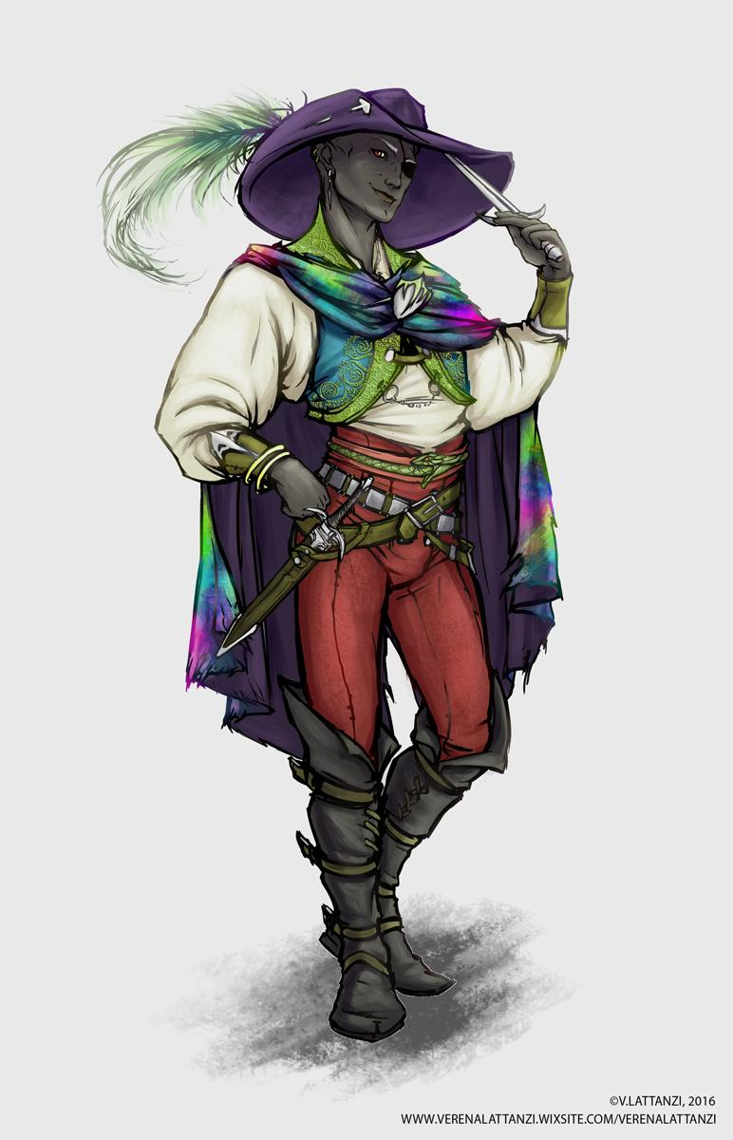
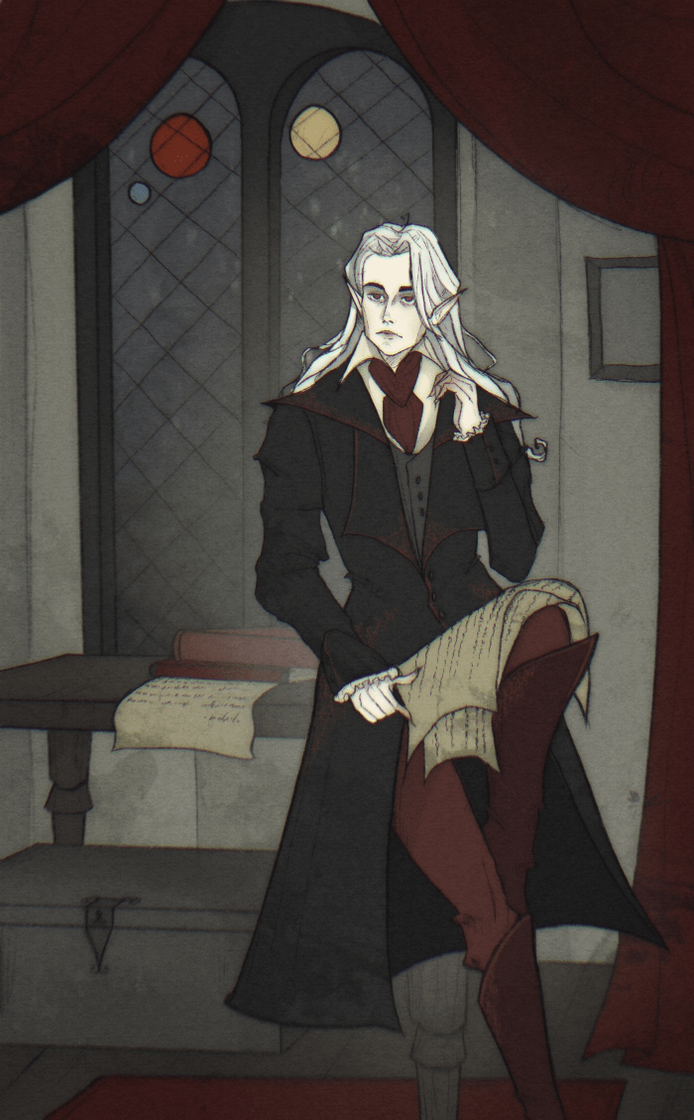
JUST KIDDING
AKA
Men I think I wholeheartedly
undoubtedly believe I can fix
“A ship is safe in harbor, but that's not what ships are for.”

